Slide 1

Not All Neighbors Matter: Point Distribution-Aware Pruning for 3D Point Cloud
Yejin Lee | Donghyun Lee | JungUk Hong
Seoul National University | Seoul National University | Yonsei University
yejinlee@snu.ac.kr | eudh1206@snu.ac.kr | junguk1616@gmail.com
Jae W. Lee | Hongil Yoon
Seoul National University | Google
jaewlee@snu.ac.kr | hongilyoon@google.com

Slide 2
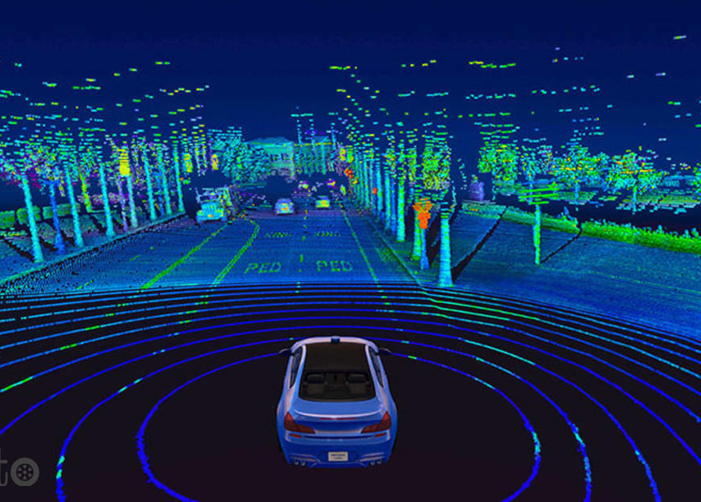


3D Point Cloud
Rapid advancements in capabilities of computing and sensors (e.g., LiDARs)
Includes 3D geometry information to represent scenes and objects
3D segmentation, detection, classification, completion, pose estimation, etc.
Autonomous Driving^{[1]}
AR/VR^{[2]}
Robotics^{[3]}
[1] https://auto.economictimes.indiatimes.com/news/auto-components/velodyne-aims-to-price-new-self-driving-car-sensor-below-500/79228575
[2] https://eonreality.com/2020-ar-vr-education-training-jamie-justice/
[3] https://futureskillsprime.in/blog/what-is-the-inherent-connection-between-robotics-and-artificial-intelligence

Slide 3
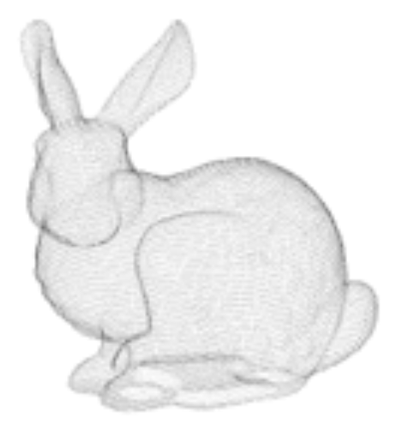
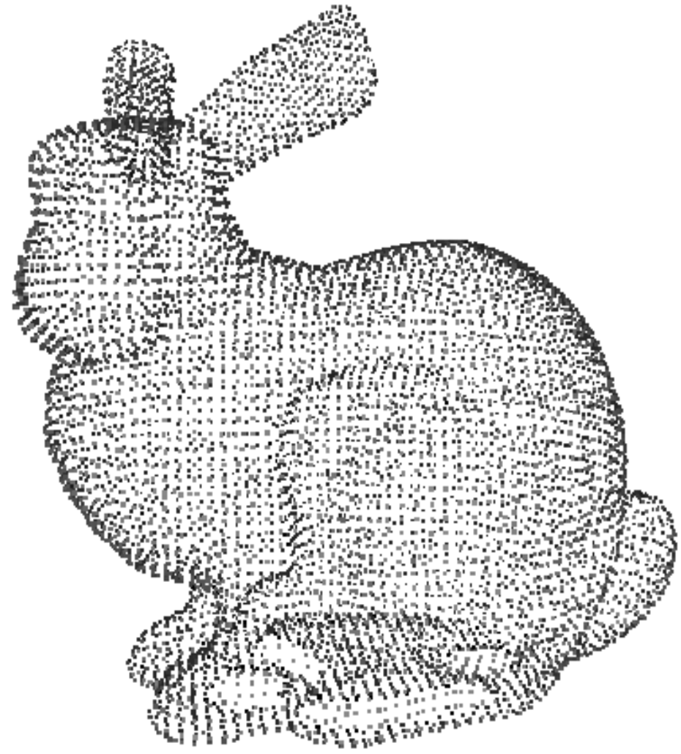
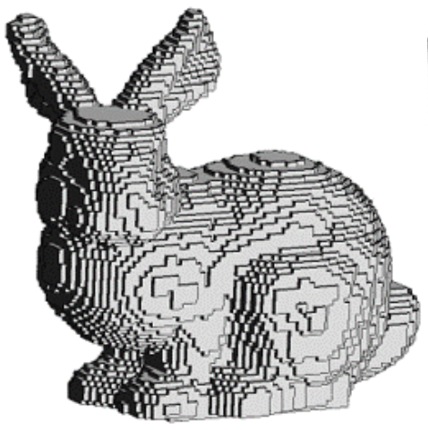
3D Point Cloud
Voxelization is used to extract useful information from 3D point cloud
Partitioning the 3D space into structured grid of voxels
3D point cloud neural networks often utilize Sparse 3D Convolution layer to process voxels
Skip operations on empty voxels
Figures from Naseer, Muzammal et al. “Indoor Scene Understanding in 2.5/3D for Autonomous Agents: A Survey.” IEEE Access 7 (2018): 1859-1887.

Slide 4

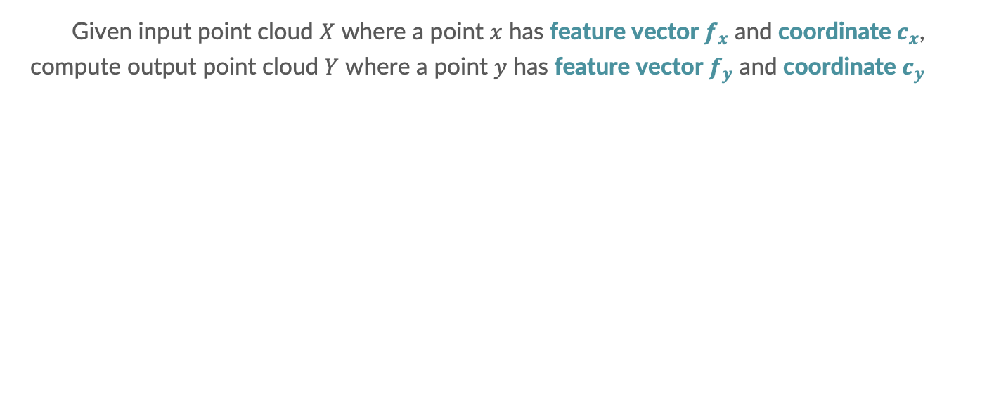
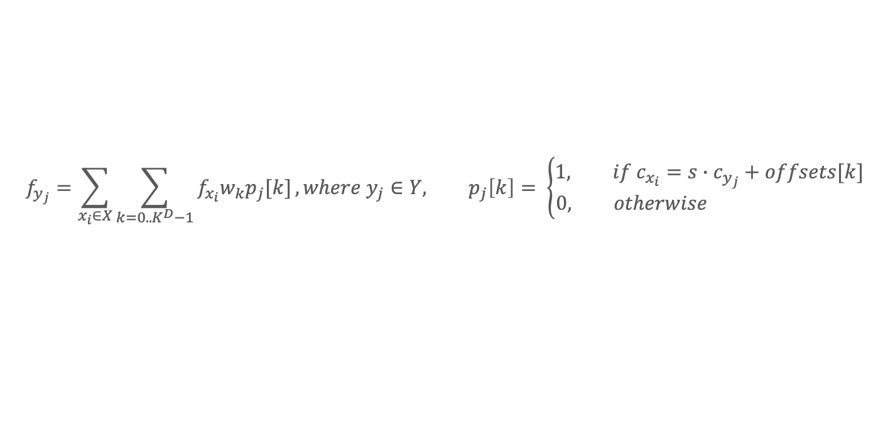
Sparse 3D Convolution
Given input point cloud $X$ where a point $x$ has feature vector $f_{x}$ and coordinate $c_{x}$,
compute output point cloud $Y$ where a point $y$ has feature vector $f_{y}$ and coordinate $c_{y}$
$$f_{y_{j}}=\sum_{x_{i}∈X}{\sum_{k=0..K^{D}−1}{f_{x_{i}}w_{k}p_{j}[k]}}, where y_{j}∈Y, p_{j}\left[k\right]= \left\{\begin{aligned}1, if c_{x_{i}}=s∙c_{y_{j}}+offsets[k] \\ 0, otherwise \end{aligned}\right.$$

Slide 5

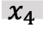
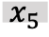
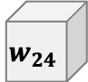
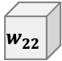
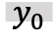
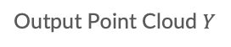
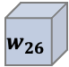
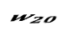

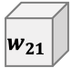
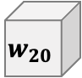
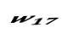
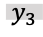
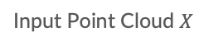
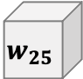
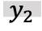
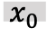
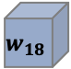

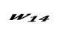
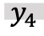
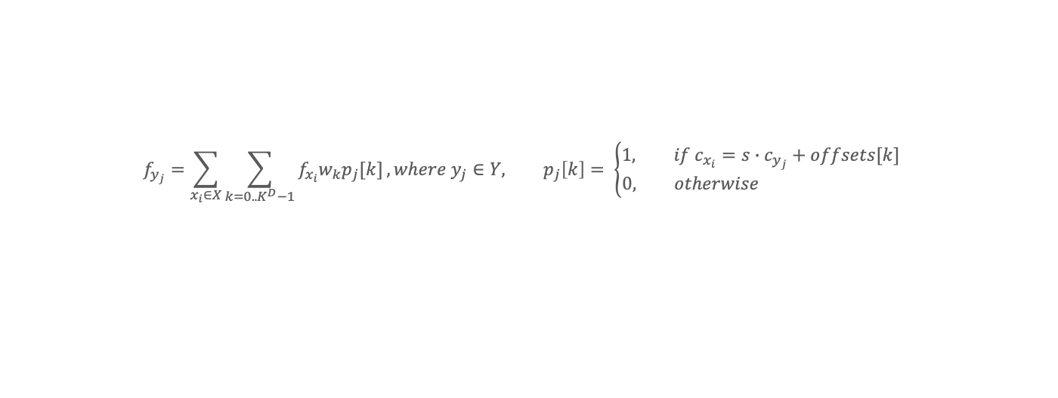
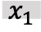
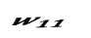


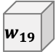
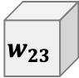
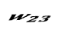

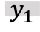
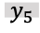
Sparse 3D Convolution
Given input point cloud $X$ where a point $x$ has feature vector $f_{x}$ and coordinate $c_{x}$, compute output point cloud $Y$ where a point $y$ has feature vector $f_{y}$ and coordinate $c_{y}$
Input Point Cloud $X$
Weight $W$
Output Point Cloud $Y$
$$w_{2}$$
$$w_{5}$$
$$w_{8}$$
Neighbors
$$w_{11}$$
$$w_{14}$$
$$w_{17}$$
$$w_{8}$$
$$x_{0}$$
$$w_{20}$$
$$w_{23}$$
$$w_{26}$$
$$w_{17}$$
$$w_{20}$$
$$w_{23}$$
$$w_{26}$$
$$y_{1}$$
$$x_{1}$$
$$w_{26}$$
$$w_{7}$$
$$y_{0}$$
$$x_{4}$$
$$w_{19}$$
$$w_{22}$$
$$w_{25}$$
$$w_{16}$$
$$y_{4}$$
$$w_{25}$$
$$x_{5}$$
$$w_{6}$$
$$y_{5}$$
$$w_{18}$$
$$w_{21}$$
$$w_{24}$$
$$w_{15}$$
$$w_{24}$$
$$x_{3}$$
$$x_{2}$$
$$y_{3}$$
$$y_{2}$$
Neighborhood Voxels
$$f_{y_{j}}=\sum_{x_{i}∈X}{\sum_{k=0..K^{D}−1}{f_{x_{i}}w_{k}p_{j}[k]}}, where y_{j}∈Y, p_{j}\left[k\right]= \left\{\begin{aligned}1, if c_{x_{i}}=s∙c_{y_{j}}+offsets[k] \\ 0, otherwise \end{aligned}\right.$$

Slide 6
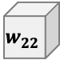
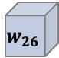
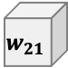


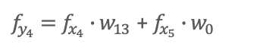
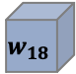
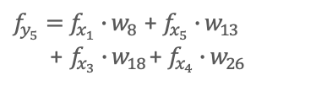
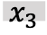
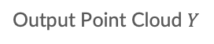
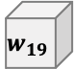
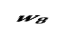
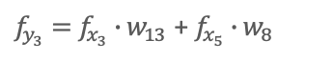
Sparse 3D Convolution
Given input point cloud $X$ where a point $x$ has feature vector $f_{x}$ and coordinate $c_{x}$, compute output point cloud $Y$ where a point $y$ has feature vector $f_{y}$ and coordinate $c_{y}$
Input Point Cloud $X$
Weight $W$
Output Point Cloud $Y$
$$w_{2}$$
$$w_{5}$$
$$w_{8}$$
$f_{y_{4}}=f_{x_{4}}∙w_{13}$+ $f_{x_{5}}∙w_{0}$
$$w_{11}$$
$$w_{14}$$
$$w_{17}$$
$$w_{8}$$
$$x_{0}$$
$$w_{20}$$
$$w_{23}$$
$$w_{26}$$
$$w_{17}$$
$$w_{20}$$
$$w_{23}$$
$$w_{26}$$
$$y_{1}$$
$$x_{1}$$
$$w_{26}$$
$$w_{7}$$
$$y_{0}$$
$f_{y_{5}}=f_{x_{1}}∙w_{8}$+ $f_{x_{5}}∙w_{13}$ + $f_{x_{3}}∙w_{18}$+ $f_{x_{4}}∙w_{26}$
$$x_{4}$$
$$w_{19}$$
$$w_{22}$$
$$w_{25}$$
$$w_{16}$$
$$y_{4}$$
$$w_{25}$$
$$x_{5}$$
$$w_{6}$$
$$y_{5}$$
$$w_{18}$$
$$w_{21}$$
$$w_{24}$$
$$w_{15}$$
$$w_{24}$$
$$x_{3}$$
$$x_{2}$$
$$y_{3}$$
$$y_{2}$$
$f_{y_{3}}=f_{x_{3}}∙w_{13}$+ $f_{x_{5}}∙w_{8}$
$$f_{y_{j}}=\sum_{x_{i}∈X}{\sum_{k=0..K^{D}−1}{f_{x_{i}}w_{k}p_{j}[k]}}, where y_{j}∈Y, p_{j}\left[k\right]= \left\{\begin{aligned}1, if c_{x_{i}}=s∙c_{y_{j}}+offsets[k] \\ 0, otherwise \end{aligned}\right.$$

Slide 7


Challenges in 3D Point Cloud Models
Challenges
↑ the size of model & dataset → ↑ computation requirement
Difficult to satisfy strict latency and energy constraints e.g., autonomous driving and robotics
Our Proposal
Spatial Point Distribution-Aware Neighborhood Pruning which is a weight pruning technique that takes advantage of spatial point distribution to prune neighborhood voxels that matter less to the output feature vector

Slide 8
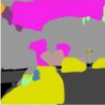
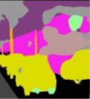
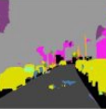
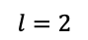
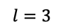
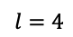

Spatial Point Distribution-Aware Neighborhood Pruning
Freq
Accuracy
Loss
.
.
.
.
$$l=1$$
$$l=2$$
.
.
Training
Set
Validation
Set
Lossless
Model
Lossy
Model
Kernel Idx
$$l=3$$
$$l=4$$
Model
candidates
Model candidates
FPS
1. Point Distribution-Aware Neighborhood Pruning
2. Search Space Exploration
3. Retraining
Step 1 Analyze neighborhood voxels for each layer and cluster
Step 2 Explore search space to find optimal configuration with max speedup & min acc loss
Step 3 Retrain to recover accuracy loss from pruning

Slide 9
Spatial Point Distribution-Aware Neighborhood Pruning
Freq
Accuracy
Loss
.
.
.
.
$$l=1$$
$$l=2$$
.
.
Training
Set
Validation
Set
Lossless
Model
Lossy
Model
Kernel Idx
$$l=3$$
$$l=4$$
Model
candidates
Model candidates
FPS
1. Point Distribution-Aware Neighborhood Pruning
2. Search Space Exploration
3. Retraining
Step 1 Analyze neighborhood voxels for each layer and cluster
Step 2 Explore search space to find optimal configuration with max speedup & min acc loss
Step 3 Retrain to recover accuracy loss from pruning

Slide 10

Analysis of Neighborhood Voxels
Probability of having a neighbor for each neighborhood voxel $Prob\left(p_{j}\left[k\right]=1\right)=\frac{\sum_{Y∈T}{\sum_{y_{j}∈Y}{p_{j}\left[k\right]}}}{\sum_{Y∈T}{\sum_{y_{j}∈Y}{p_{j}\left[center\right]}}}, where T is training set, center is where y_{j} resides$
41th(last) layer of Stanford^{[1]} Dataset
[1] I. Armeni et al., "3D Semantic Parsing of Large-Scale Indoor Spaces," 2016 IEEE Conference on Computer Vision and Pattern Recognition (CVPR), 2016, pp. 1534-1543

Slide 11








































Clustering Neighborhood Voxels
Group neighborhood voxels whose probabilities are similar
$$w_{2}$$
$$w_{5}$$
$$w_{8}$$
$$w_{11}$$
$$w_{14}$$
$$w_{17}$$
$$w_{8}$$
$$w_{20}$$
$$w_{23}$$
$$w_{26}$$
$$w_{17}$$
$$w_{20}$$
$$w_{23}$$
$$w_{26}$$
$$w_{26}$$
$$w_{7}$$
$$w_{19}$$
$$w_{22}$$
$$w_{25}$$
$$w_{16}$$
$$w_{25}$$
$$w_{6}$$
$$w_{18}$$
$$w_{21}$$
$$w_{24}$$
$$w_{15}$$
$$w_{24}$$
$$w_{5}$$
$$l=0$$
$$w_{11}$$
$$w_{14}$$
$$w_{17}$$
$$w_{11}$$
$$w_{23}$$
$$w_{17}$$
$$w_{14}$$
$$w_{14}$$
$$w_{23}$$
$$w_{17}$$
$$w_{7}$$
$$w_{7}$$
$$w_{16}$$
$$w_{10}$$
$$w_{16}$$
$$w_{19}$$
$$w_{22}$$
$$w_{25}$$
$$w_{16}$$
$$w_{19}$$
$$w_{22}$$
$$w_{25}$$
$$w_{16}$$
$$w_{22}$$
$$w_{16}$$
$$w_{22}$$
$$w_{16}$$
41th(last) layer of Stanford^{[1]} Dataset
$$w_{25}$$
$$w_{25}$$
$$w_{9}$$
$$w_{15}$$
$$w_{12}$$
$$w_{12}$$
$$w_{21}$$
$$w_{15}$$
Degree of pruning
$$l=1$$
$$l=2$$
$$l=3$$
$$l=4$$

Slide 12




Analysis of Neighborhood Voxels
$Prob\left(p_{j}\left[k\right]=1\right)$ is dependent on spatial point distribution of the dataset
→ Compress spatial point distribution information into $K^{D}$ probabilities
$Prob\left(p_{j}\left[k\right]=1\right)$ is an effective metric for reflecting dataset property and determining which neighborhood voxels to prune

Slide 13




Spatial Point Distribution-Aware Neighborhood Pruning
Freq
Accuracy
Loss
.
.
.
.
$$l=1$$
$$l=2$$
.
.
Training
Set
Validation
Set
Lossless
Model
Lossy
Model
Kernel Idx
$$l=3$$
$$l=4$$
Model
candidates
Model candidates
FPS
1. Point Distribution-Aware Neighborhood Pruning
2. Search Space Exploration
3. Retraining
Step 1 Analyze neighborhood voxels for each layer and cluster
Step 2 Explore search space to find optimal configuration with max speedup & min acc loss
Step 3 Retrain to recover accuracy loss from pruning

Slide 14


Search Space Exploration
Each layer has different levels of tolerance to errors
Assuming $N$ layers and $M$ clusters, # of possible combinations = $M^{N}$
e.g., $N=40, M=5$ → $5^{40}≈\text{9.094947}\text{e}\text{ + 27}$
We need to reduce the search space!

Slide 15

Search Space Exploration
Constraint#1 Apply the same $l$ to a group of consecutive layers whose neighbor
distributions are identical
Now, $N$ is the number of layer groups
$L=[l_{0}, l_{1},…, l_{N−1}]$ where $l_{i}$ is the degree of neighborhood pruning for layer group i
Sparse 3D Convolution
Layer i
Sparse 3D Convolution
Layer i+1
Input Point Cloud
Output Point Cloud
Output Point Cloud
Coordinates remain the same!
Only Features are updated

Slide 16






Search Space Exploration
Constraint#2 Evaluate each layer’s sensitivity to pruning with Pruning-Friendliness ($PF$)
$PF_{i}=\left|\frac{flops_reduction}{accuracy_loss}\right|$ when $l_{i}=M−1$ is applied to only the given layer group $i$
e.g., $N=4, M=5$, we compute $PF$ for each layer group
FLOPs Reduction
÷
$$=PF_{3}$$
$$=PF_{1}$$
$$=PF_{0}$$
$$=PF_{2}$$
$$w_{10}$$
$$w_{16}$$
$$w_{22}$$
$$w_{16}$$
Acc loss
$$l=4$$
Layer
Group 0
Layer
Group 1
Layer
Group 2
Layer
Group 3

Slide 17

Search Space Exploration
Constraint#2 Evaluate each layer’s sensitivity to pruning with Pruning-Friendliness ($PF$)
$PF_{i}=\left|\frac{flops_reduction}{accuracy_loss}\right|$ when $l_{i}=M−1$ is applied to only the given layer group $i$

Slide 18



Search Space Exploration
Constraint#2 Evaluate each layer’s sensitivity to pruning with Pruning-Friendliness ($PF$)
$PF_{i}=\left|\frac{flops_reduction}{accuracy_loss}\right|$ when $l_{i}=M−1$ is applied to only the given layer group $i$
Higher $PF$: Relatively smaller accuracy loss with larger computation reduction
→ Robust to pruning
Lower $PF$: Relatively larger accuracy loss with smaller computation reduction
→ Sensitive to pruning

Slide 19



















Search Space Exploration
Constraint#2 Evaluate each layer’s sensitivity to pruning with Pruning-Friendliness ($PF$)
$PF_{i}=\left|\frac{flops_reduction}{accuracy_loss}\right|$ when $l_{i}=M−1$ is applied to only the given layer group $i$
Apply more aggressive pruning to more robust layers
$$l_{i}≥l_{j} where PF_{i}≥PF_{j}$$
$$PF_{6}$$
$$≥PF_{7}$$
$$≥PF_{5}$$
$$≥PF_{4}$$
$$≥PF_{2}$$
$$≥PF_{0}$$
$$≥PF_{3}$$
$$≥PF_{1}$$
$$l_{6}$$
$$≥ l_{7}$$
$$≥ l_{5}$$
$$≥ l_{4}$$
$$≥ l_{2}$$
$$≥ l_{0}$$
$$≥ l_{3}$$
$$≥ l_{1}$$
$M^{N}$ $._{M}H_{N}=._{M+N−1}C_{N}$
e.g., $N=4$, $M=5$ $5^{4}=625$ → $._{5+4−1}C_{4}=70$

Slide 20












Search Space Exploration
Constraint#3 Skip more aggressive configs than the current config if the validation accuracy of the current config is below the threshold $t$
Configuration $L_{a}$ is more aggressive than $L_{b}$, if $L_{a}\left[i\right]≥L_{b}\left[i\right] for i=0,..,N−1$
$L_{a}=$[4, 3, 1, 1, 0]
$L_{b}=$[4, 2, 1, 1, 0]
$L_{a}$ is more aggressive than $L_{b}$
$$≥$$
$$≥$$
$$≥$$
$$≥$$
$$≥$$
$L_{a}=$[4, 3, 1, 1, 0]
$L_{b}=$[4, 2, 2, 1, 0]
$$≥$$
$$≥$$
$$≥$$

Slide 21

Search Space Exploration
$$N=4, M=4, t=−20\% below model accuracy$$
[0, 0, 0, 0]
High
PF
Low
PF

Slide 22


Search Space Exploration
$$N=4, M=4, t=−20\% below model accuracy$$
Val Acc Check
Val Acc Check
[0, 0, 0, 0]
OK
1
OK
[2, 1, 0, 0]
1
OK
FAIL
[1, 0, 0, 0]
[2, 1, 1, 0]
1
1
[1, 1, 0, 0]
OK
[2, 1, 1, 1]
[1, 1, 1, 0]
OK
[2, 2, 0, 0]
OK
1
2
[1, 1, 1, 1]
OK
[2, 2, 1, 0]
1
1
FAIL
[2, 0, 0, 0]
OK
2
[2, 2, 1, 1]

Slide 23
Search Space Exploration
$$N=4, M=4, t=−20\% below model accuracy$$
Val Acc Check
Val Acc Check
[2, 1, 0, 0]
OK
[2, 2, 2, 0]
[2, 1, 1, 0]
FAIL
[2, 2, 2, 1]
[2, 1, 1, 1]
[2, 2, 2, 2]
[2, 2, 0, 0]
OK
3
OK
[3, 0, 0, 0]
[2, 2, 1, 0]
FAIL
[3, 1, 0, 0]
FAIL
1
[2, 2, 1, 1]
[3, 1, 1, 0]

Slide 24
Search Space Exploration
$$N=4, M=4, t=−20\% below model accuracy$$
Val Acc Check
Val Acc Check
[2, 2, 2, 0]
[3, 1, 1, 1]
[2, 2, 2, 1]
[3, 2, 0, 0]
[2, 2, 2, 2]
[3, 2, 1, 0]
[3, 0, 0, 0]
OK
[3, 2, 1, 1]
[3, 1, 0, 0]
FAIL
...
[3, 1, 1, 0]
[3, 3, 3, 3]

Slide 25
Spatial Point Distribution-Aware Neighborhood Pruning
Freq
Accuracy
Loss
.
.
.
.
$$l=1$$
$$l=2$$
.
.
Training
Set
Validation
Set
Lossless
Model
Lossy
Model
Kernel Idx
$$l=3$$
$$l=4$$
Model
candidates
Model candidates
FPS
1. Point Distribution-Aware Neighborhood Pruning
2. Search Space Exploration
3. Retraining
Step 1 Analyze neighborhood voxels for each layer and cluster
Step 2 Explore search space to find optimal configuration with max speedup & min acc loss
Step 3 Retrain to recover accuracy loss from pruning

Slide 26

Evaluation
Spconv
MinkowskiEngine
TorchSparse
Lossless Configuration that reaches or exceeds the baseline accuracy metric
Lossy Configuration that shows 1% lower accuracy metric at maximum
Lossless 49.45% FLOPs reduction / Lossy 62.93% FLOPs reduction

Slide 27
Evaluation
NVIDIA GV100
Lossless 1.60x speedup / Lossy 1.97x speedup

Slide 28
Evaluation
NVIDIA GV100
Lossless 1.74x energy efficiency improvement Lossy 2.22x energy efficiency improvement

Slide 29
Summary
Sparse 3D convolution is one of the key operations in processing 3D point cloud NNs
Exploiting the sparse nature of 3D point cloud, we observe that particular groups of neighborhood voxels more frequently contribute to the output features
Based on the analysis, we propose spatial point distribution-aware weight pruning technique that achieves substantial improvement in speedup and energy consumption
Source code available at https://github.com/SNU-ARC/NotAllNeighborsMatter.git

Slide 30
Not All Neighbors Matter: Point Distribution-Aware Pruning for 3D Point Cloud
Yejin Lee | Donghyun Lee | JungUk Hong
Seoul National University | Seoul National University | Yonsei University
yejinlee@snu.ac.kr | eudh1206@snu.ac.kr | junguk1616@gmail.com
Jae W. Lee | Hongil Yoon
Seoul National University | Google
jaewlee@snu.ac.kr | hongilyoon@google.com

